Slide 1

Spring of Code
Artificial Intelligence
(Machine Learning & Deep Learning)
Instructor
Asad Ullah
- Research Assistant (DIP Lab)
Duration
03 Months
(Feb – April)

Slide 2
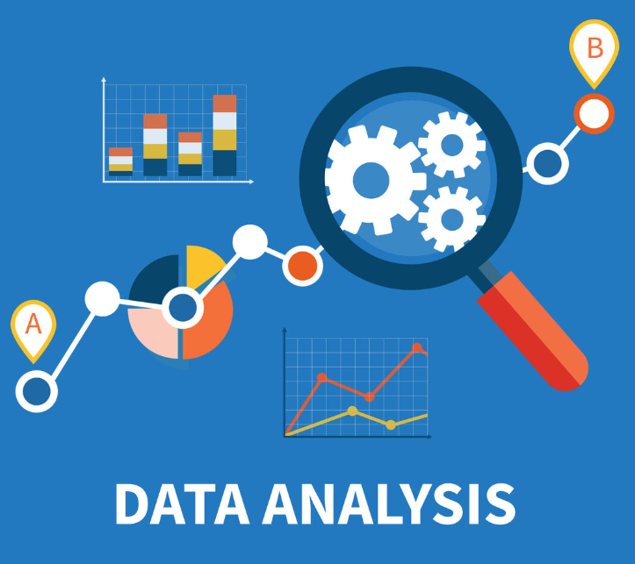
Day 02 – Exploratory Data Analysis
(Introduction to Pandas)
Objectives:
Introduction to Pandas
Series and DataFrame
Operations on DataFrame
Handling Missing Data

Slide 3
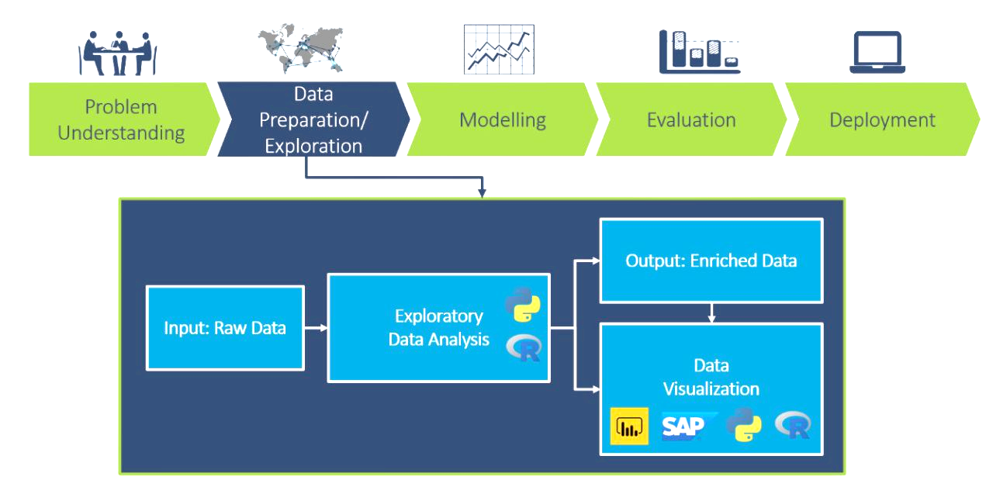
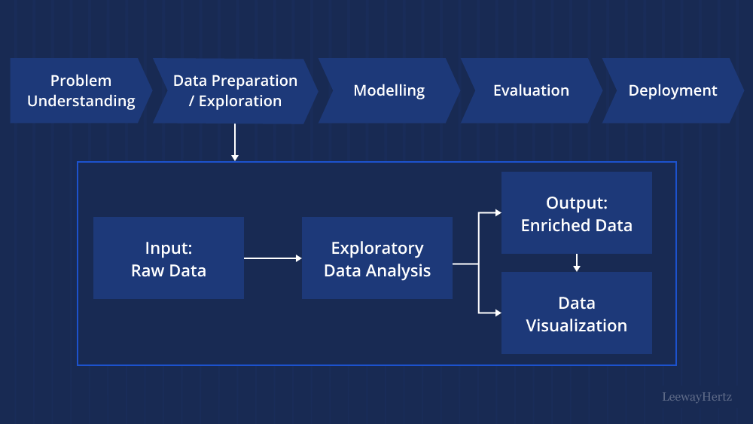
Exploratory Data Analysis
The process of examining datasets to summarize their main characteristics. It is a crucial step in the data analysis workflow to gain a deep understanding of the dataset before modeling.
Notes:
NumPy and Pandas are essential for data manipulation
Data visualization helps students see patterns and understand data quality
Data Manipulation refers to the process of cleaning, transforming, and restructuring data to make it suitable for analysis.

Slide 4
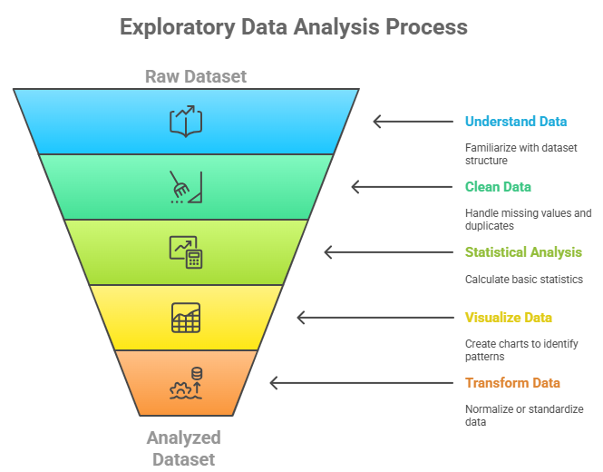
Key Steps in EDA
Understanding the Data: Get familiar with the dataset, check number of rows, columns, and data types.
Data Cleaning: Handle missing values, duplicates, and inconsistencies.
Statistical Analysis: Use basic statistics (mean, median, standard deviation) to summarize each variable.
Data Visualization: Use charts to uncover patterns, trends and outliers.
Data Transformation (if needed): Normalize or standardize values, or convert data into a better format for further analysis or modeling.
Notes:
Understand with statistics - Get basic numerical understanding
Transform last - Based on what you discovered, decide what transformations are needed
What EDA looks like for non-tabular data:
🔹 Image Data EDA
- Display sample images from different classes
- Check image sizes, aspect ratios, and color channels

Slide 5




Python Libraries for EDA
NumPy: Essential for numerical operations in Python, it provides support for multi-dimensional arrays, along with mathematical functions on these arrays.
Pandas: Library for data manipulation and analysis. It makes it easy to clean, transform, and aggregate data.
Matplotlib: A versatile plotting library used to create static, interactive, and animated visualizations in Python.
sklearn: Primarily a machine learning library but includes many tools useful for data preprocessing and feature selection, which are key parts of EDA.

Slide 6

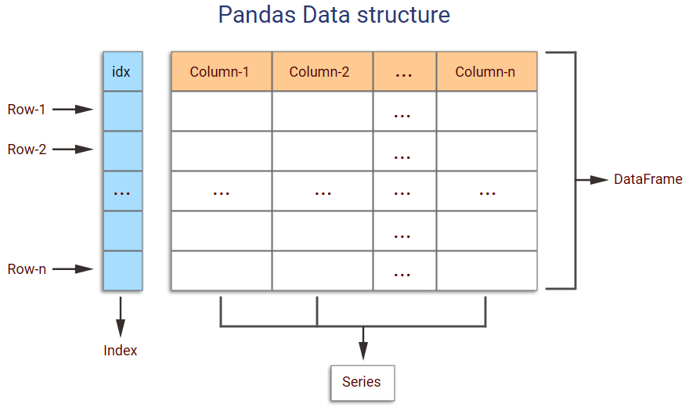
Introduction to Pandas
Pandas: The foundational library for data analysis in Python.
  Initial release: 2009
  Built on top of NumPy library
  Core Data Structure: Series and DataFrame, which are basically NumPy arrays with additional functionalities for data analysis.
Why Pandas?
  Handles structured data efficiently.
  Simplifies tasks like data cleaning, transformation, and visualization.
  Offers powerful tools for working with tabular and time-series data.
import pandas as pd
print(pd.__version__)
Notes:
Built on NumPy: "Pandas doesn't reinvent the wheel. It wraps NumPy arrays and adds two critical things:
Labels — named rows and columns instead of just integer indices
Built-in tools — for cleaning, grouping, merging, and analyzing data"
Two Core Data Structures:
Series — 1-dimensional labeled array (like one column of a spreadsheet)
DataFrame — 2-dimensional labeled table (like a full spreadsheet or SQL table)

Slide 7
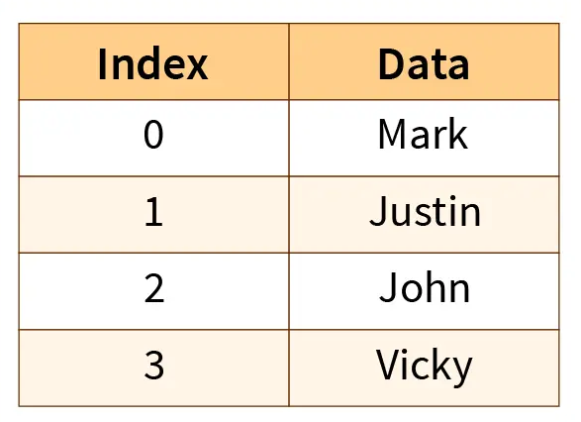
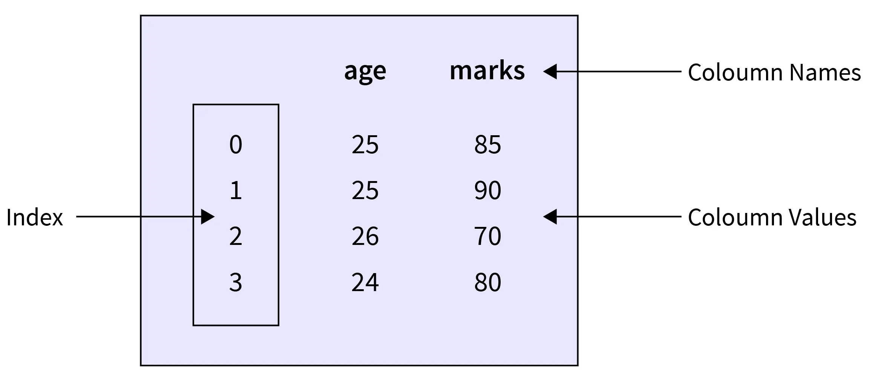
Pandas Data Structures
Series
Series:
  A 1-dimensional, array-like structure with labeled indices.
  Used for storing and manipulating a single column or list of data.
  DataFrame:
  A 2-dimensional tabular structure with rows and columns.
  Can be created from dictionaries, lists, or NumPy arrays.
  Key Features:
  Supports heterogeneous data types.
  Easy data manipulation and aggregation.
  Offers methods to filter, group, and transform data efficiently.
DataFrame

Slide 8
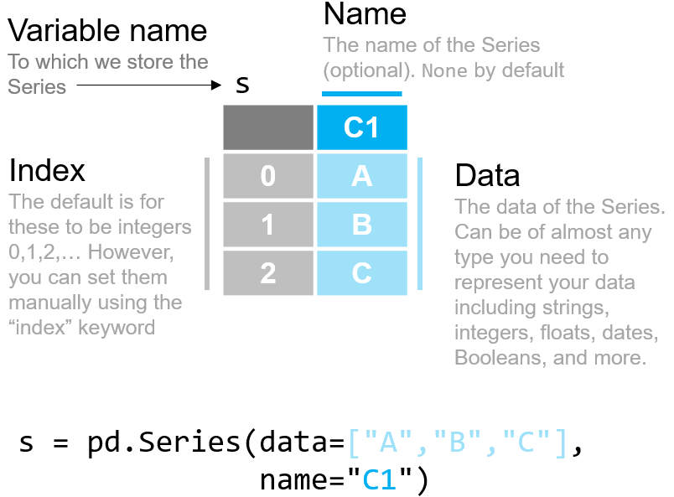
Pandas Series

Slide 9
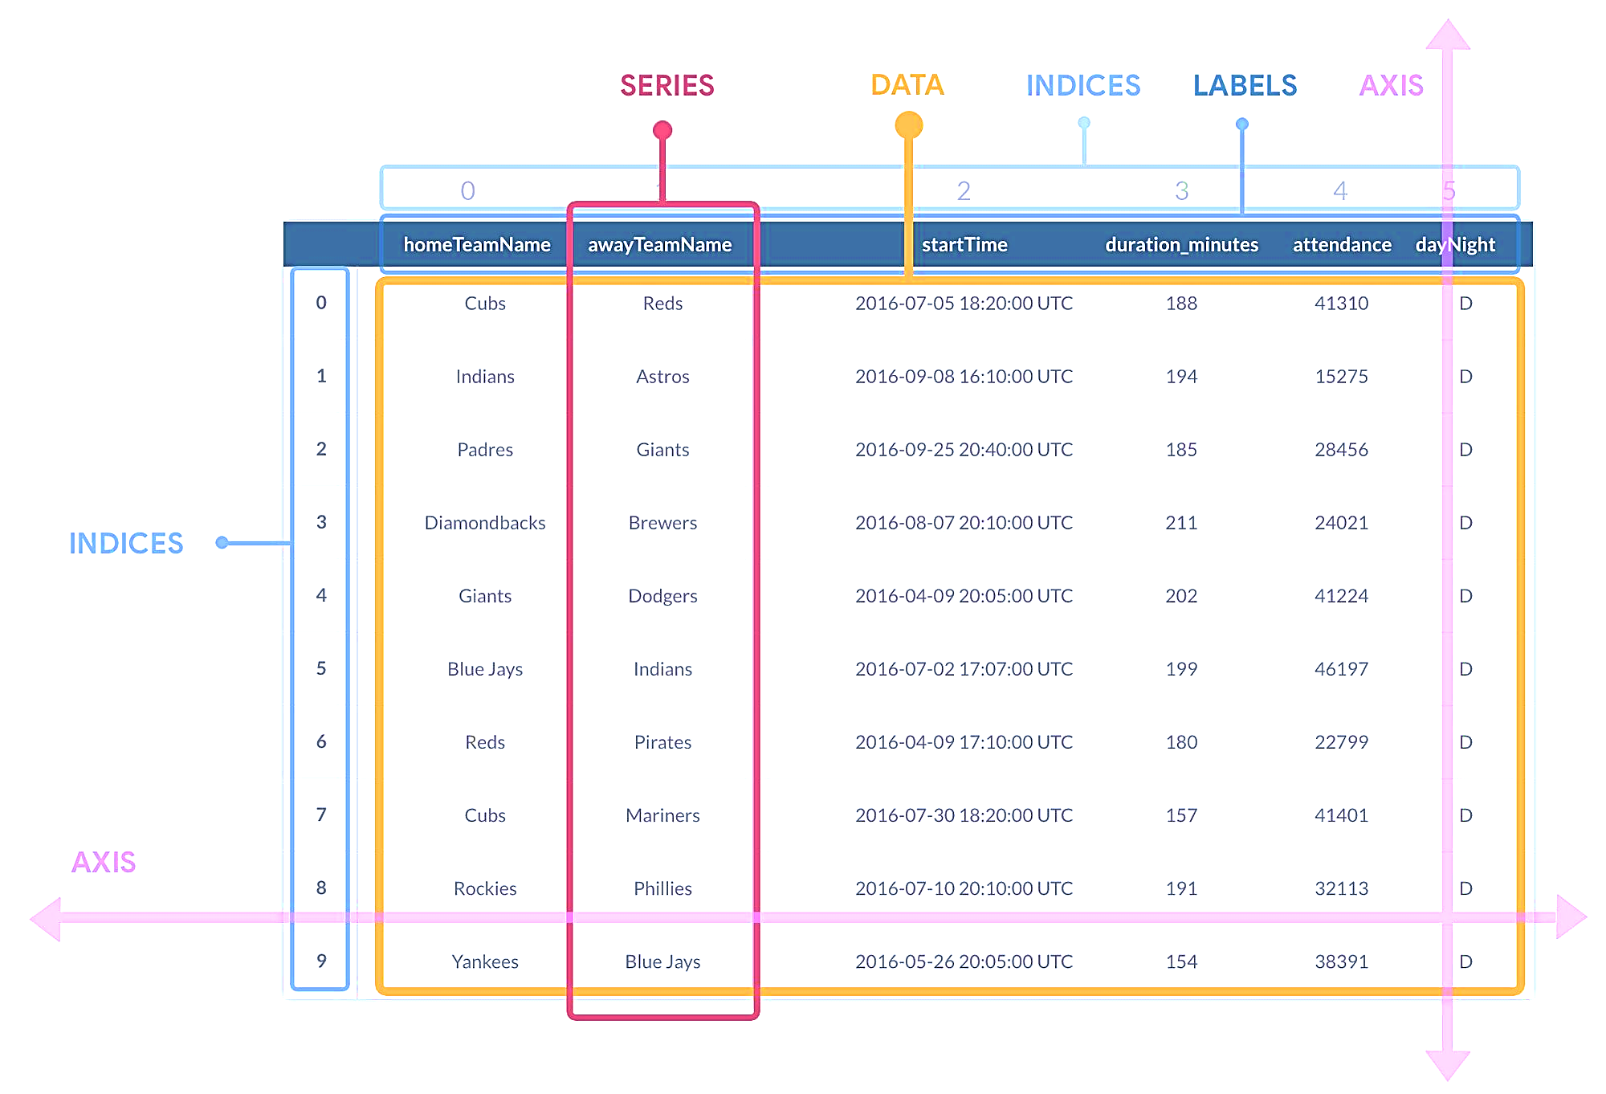
Pandas DataFrame

Slide 10
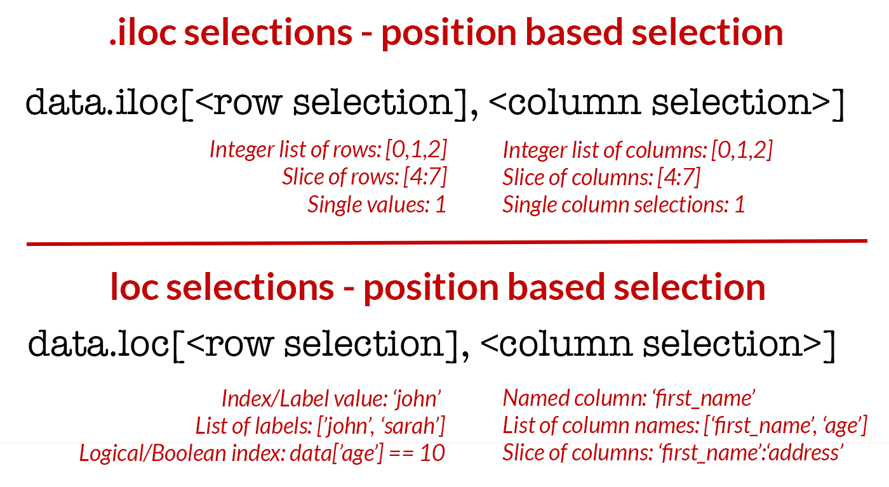
Indexing and Selection

Slide 11
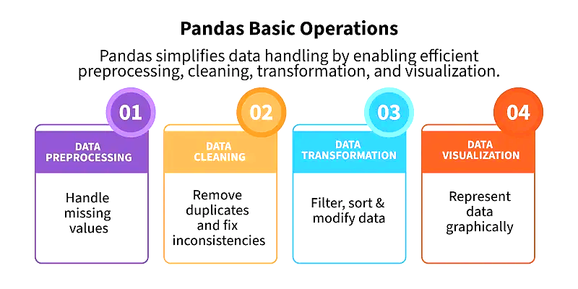

Slide 12
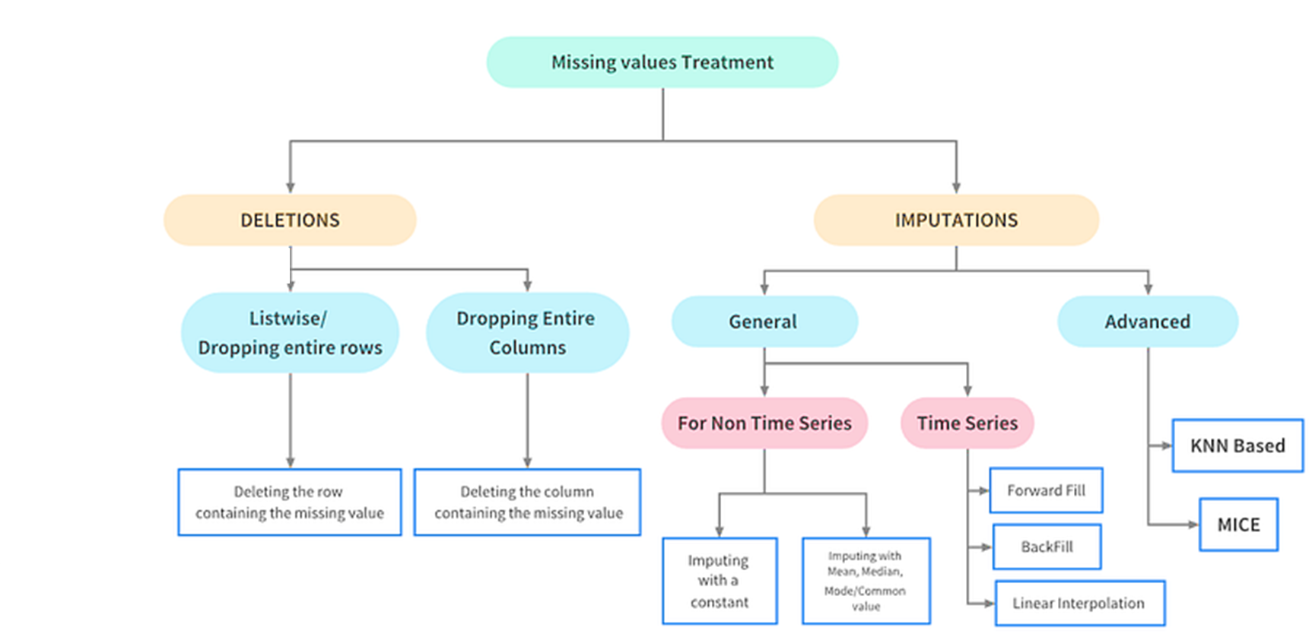
Handling Missing Values

Slide 13

Thank You

